Slide 1
Prediction for Credit card Approval
Nehal Rani Sinha

Slide 2
Problem Statement
The primary objective of this project is to predict the approval or rejection of credit card applications.
The challenge lies in understanding the key factors influencing credit card approval decisions and building a predictive model to assist in decision-making.

Slide 3
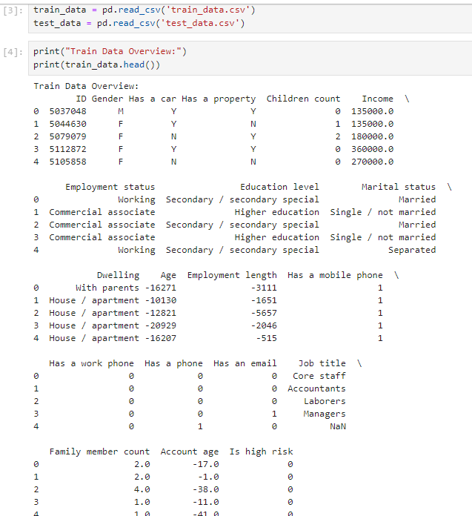
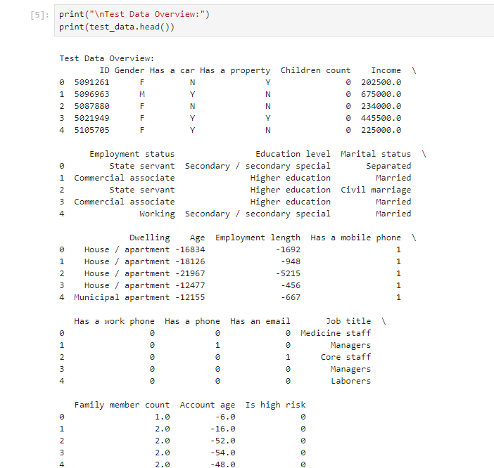
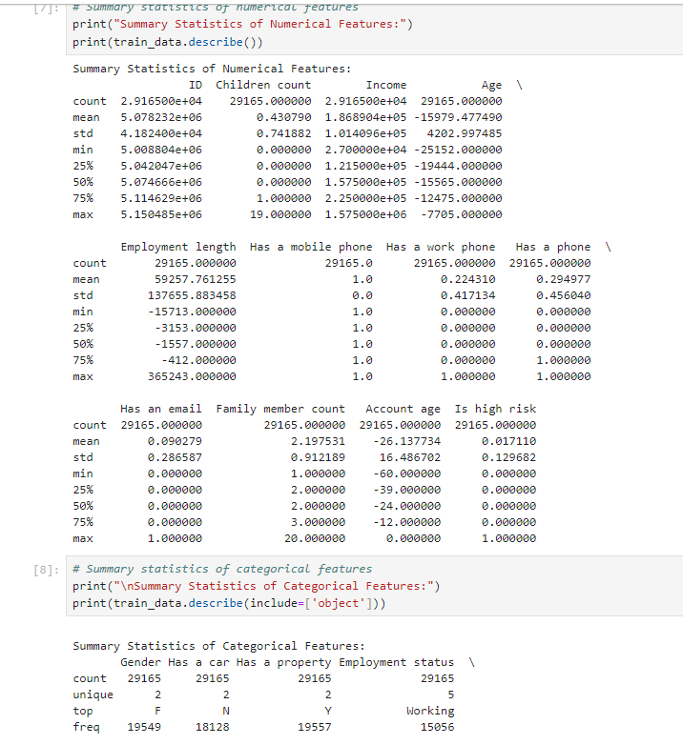
Loading Dataset and Knowing the Data

Slide 4
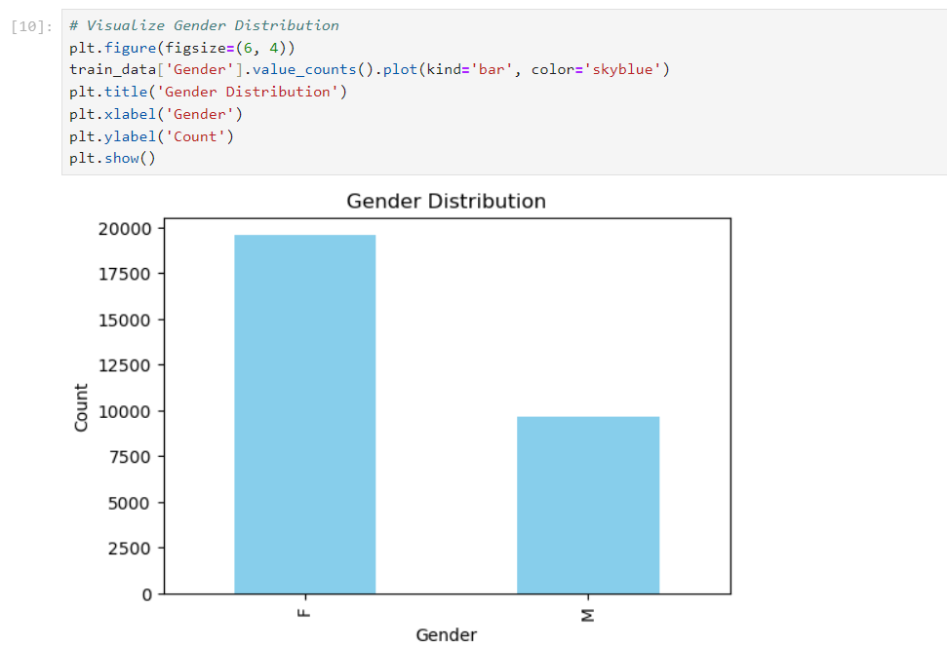
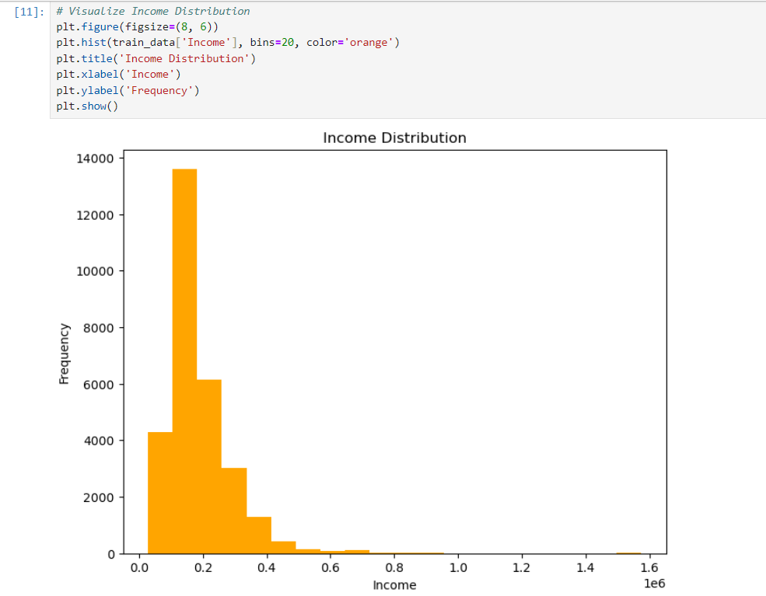
Analysis

Slide 5
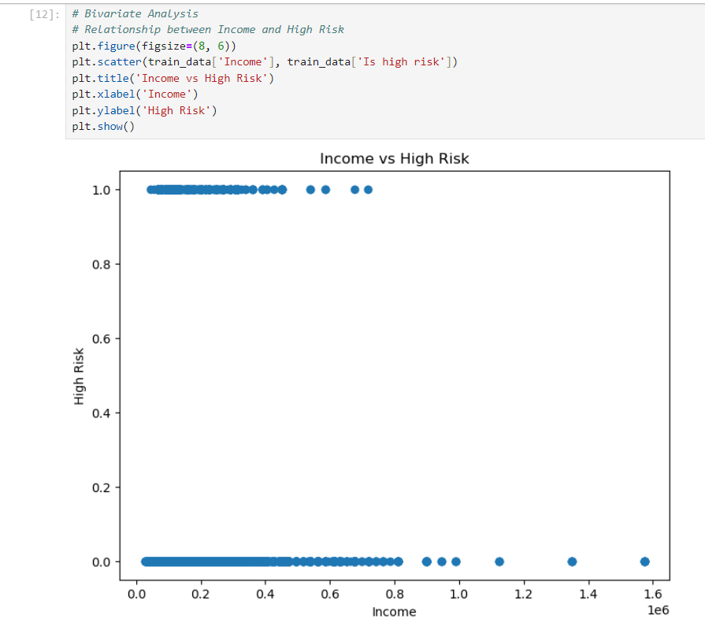
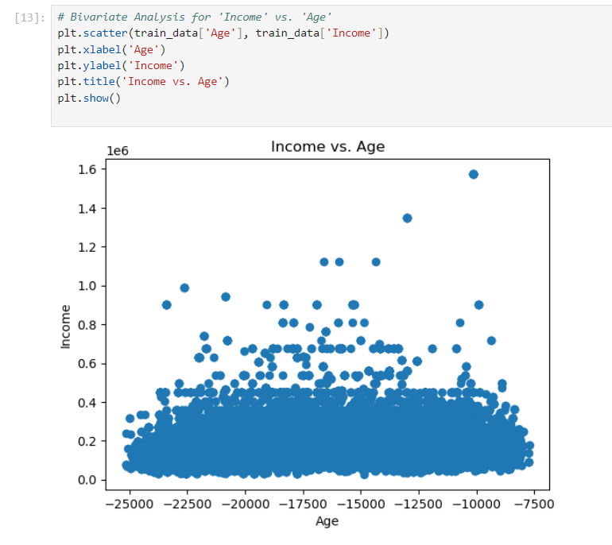
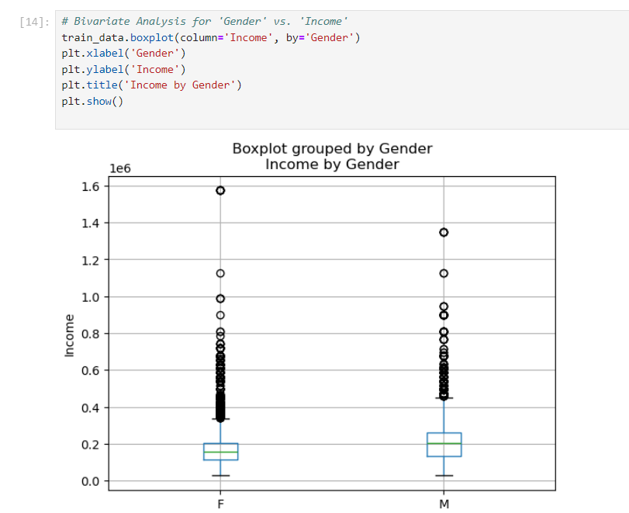
Analysis

Slide 6
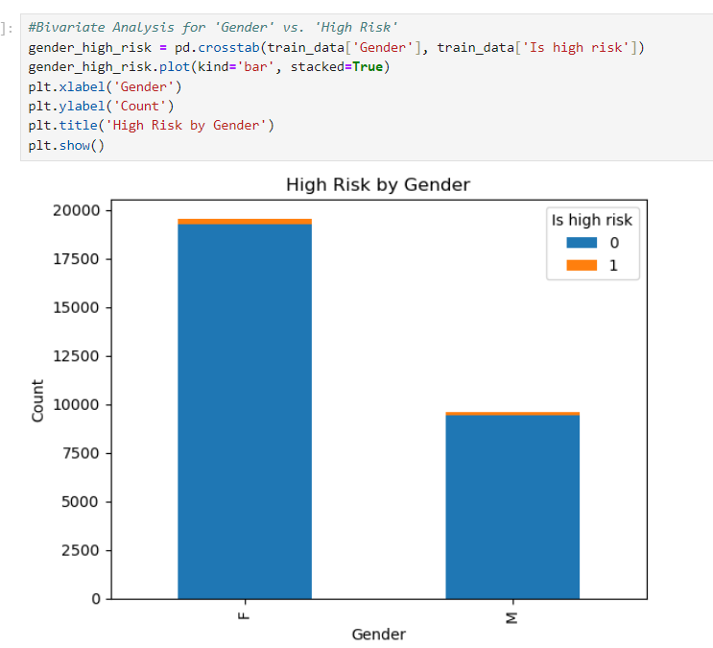
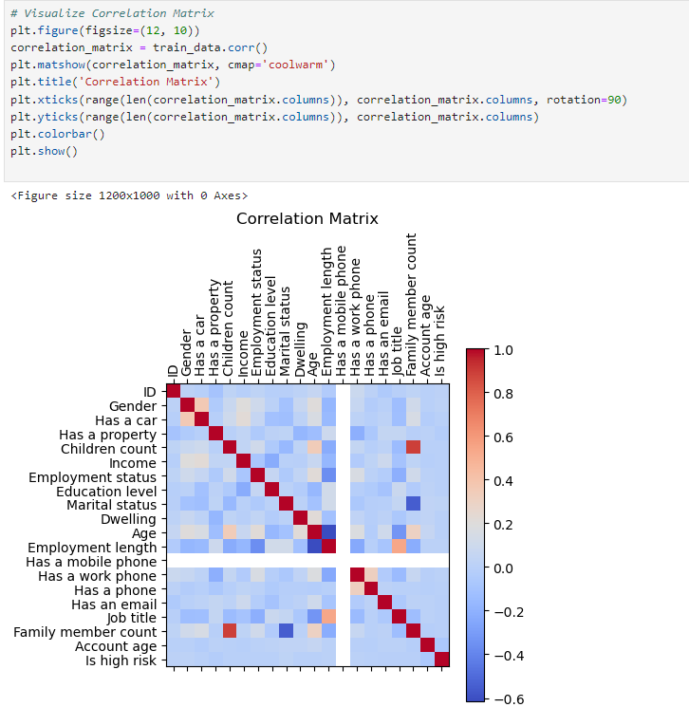
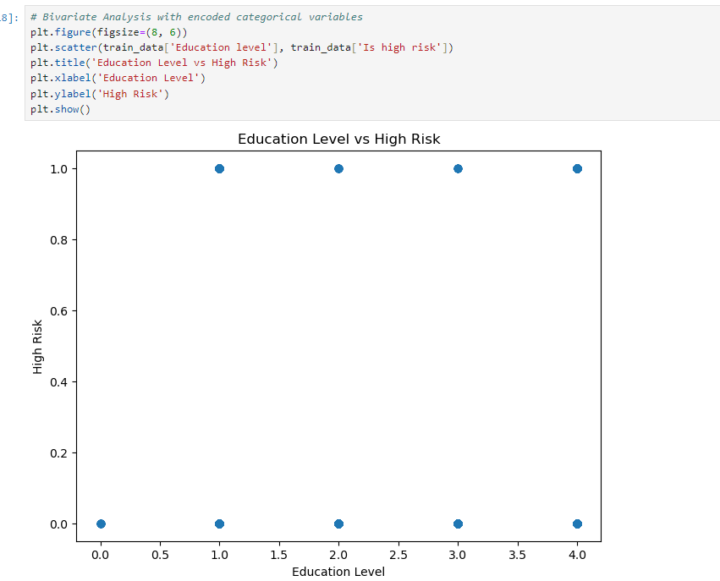
Analysis

Slide 7


Feature Engineering

Slide 8
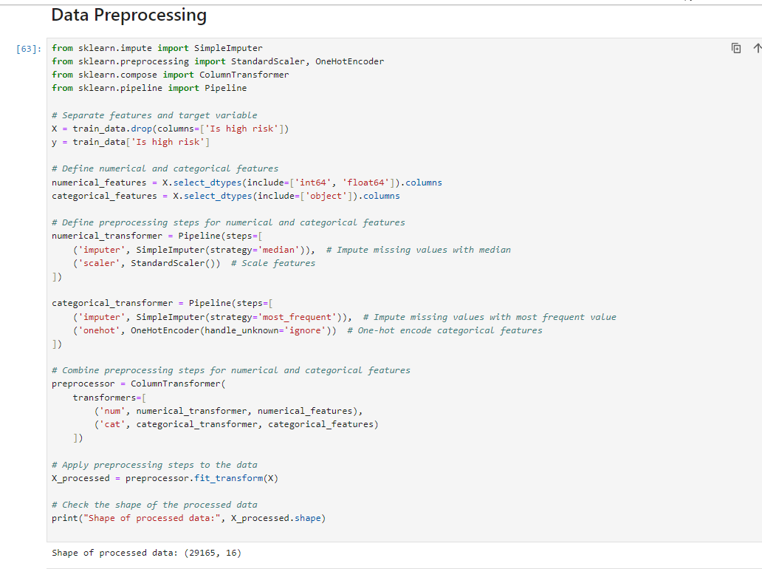
Data Pre-processing

Slide 9
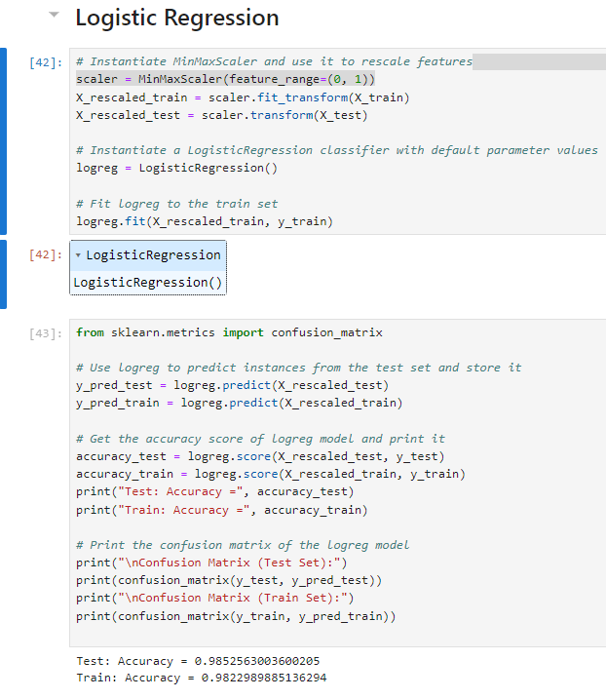
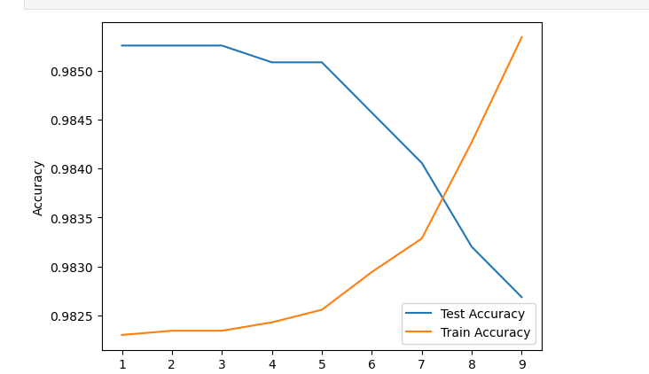
Machine Learning Models and Classification
Logistic Regression

Slide 10
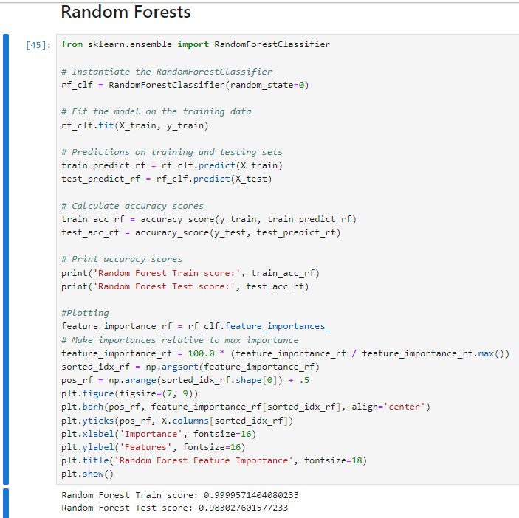
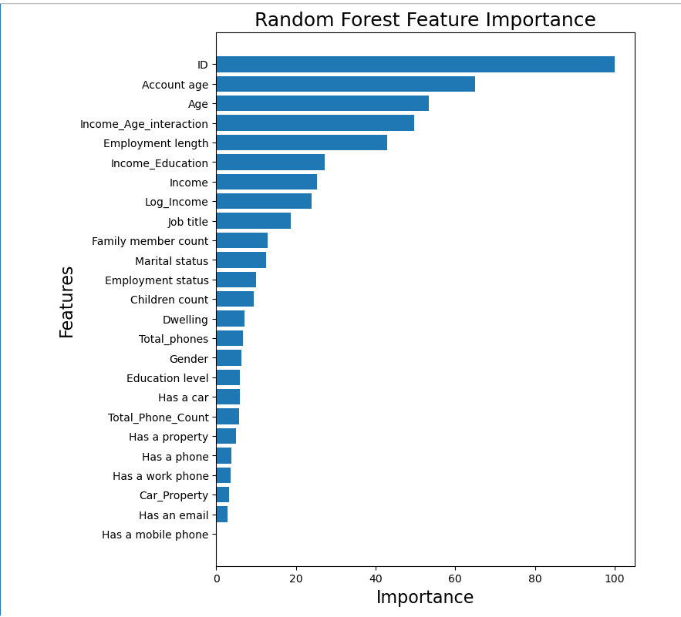
Machine Learning Models and Classification

Slide 11
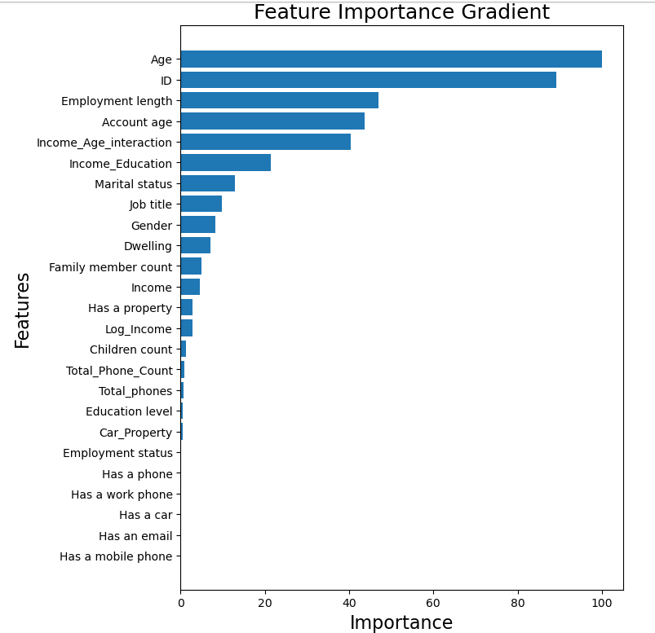
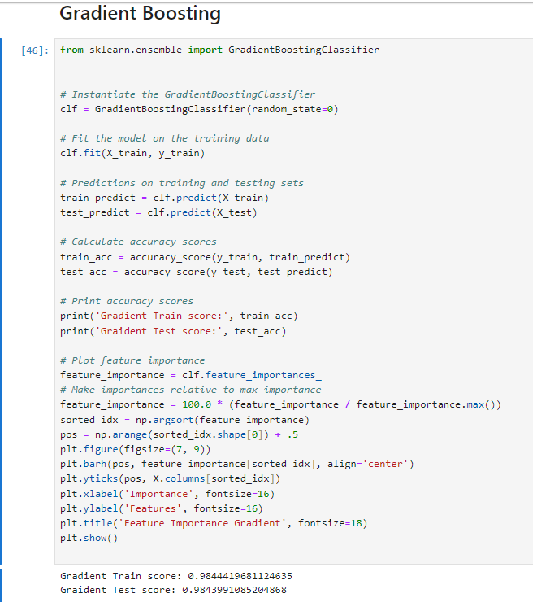
Machine Learning Models and Classification

Slide 12
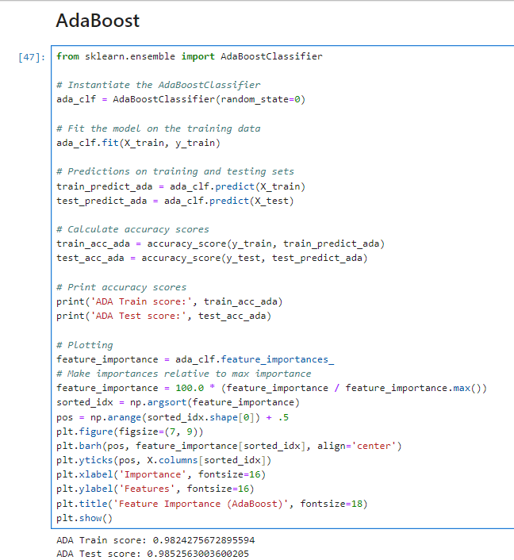
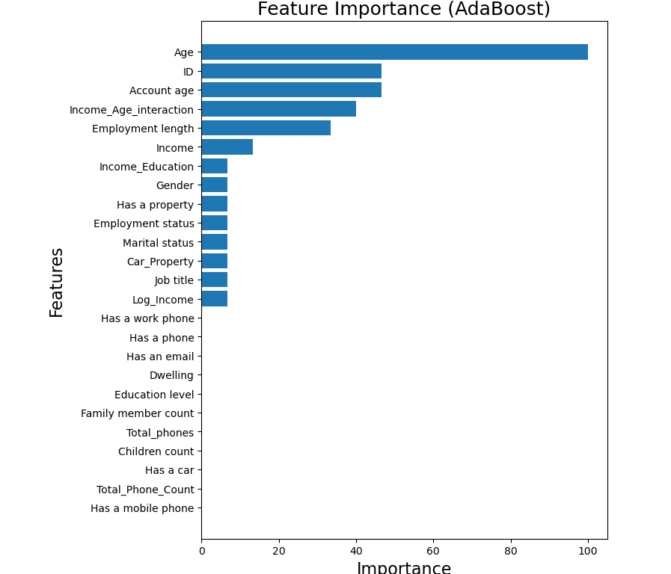
Machine Learning Models and Classification

Slide 13
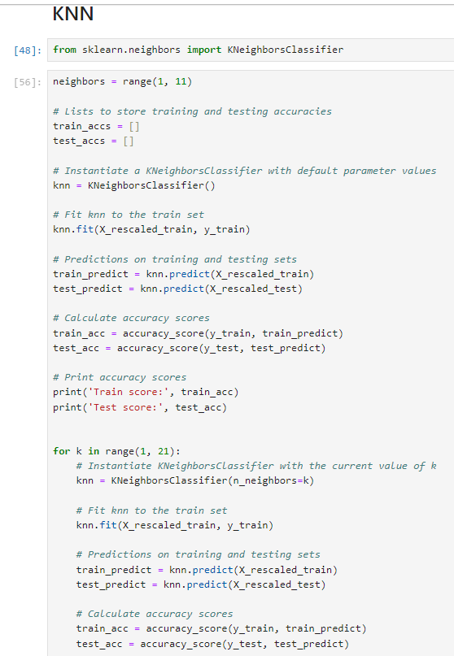
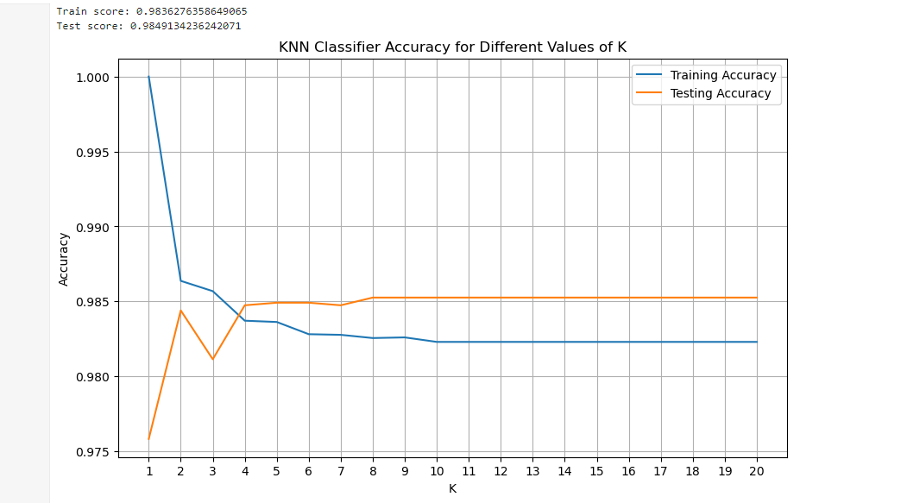
Machine Learning Models and Classification

Slide 14

Model Evaluation
Logistic Regression has the highest test accuracy of 98.525%

Slide 15
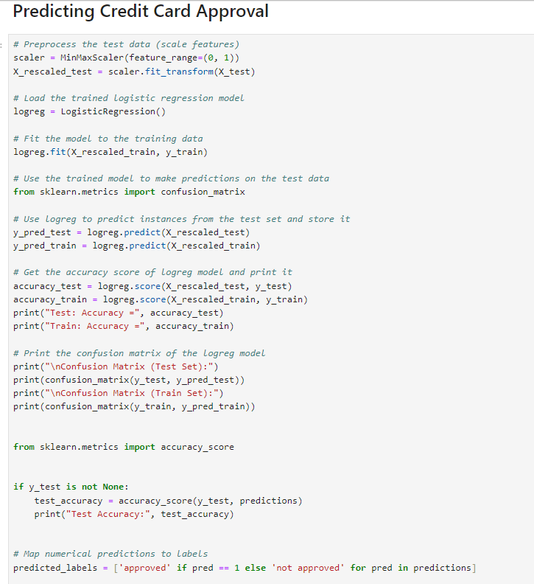

Predicting Credit Card Approval

